Slide 1
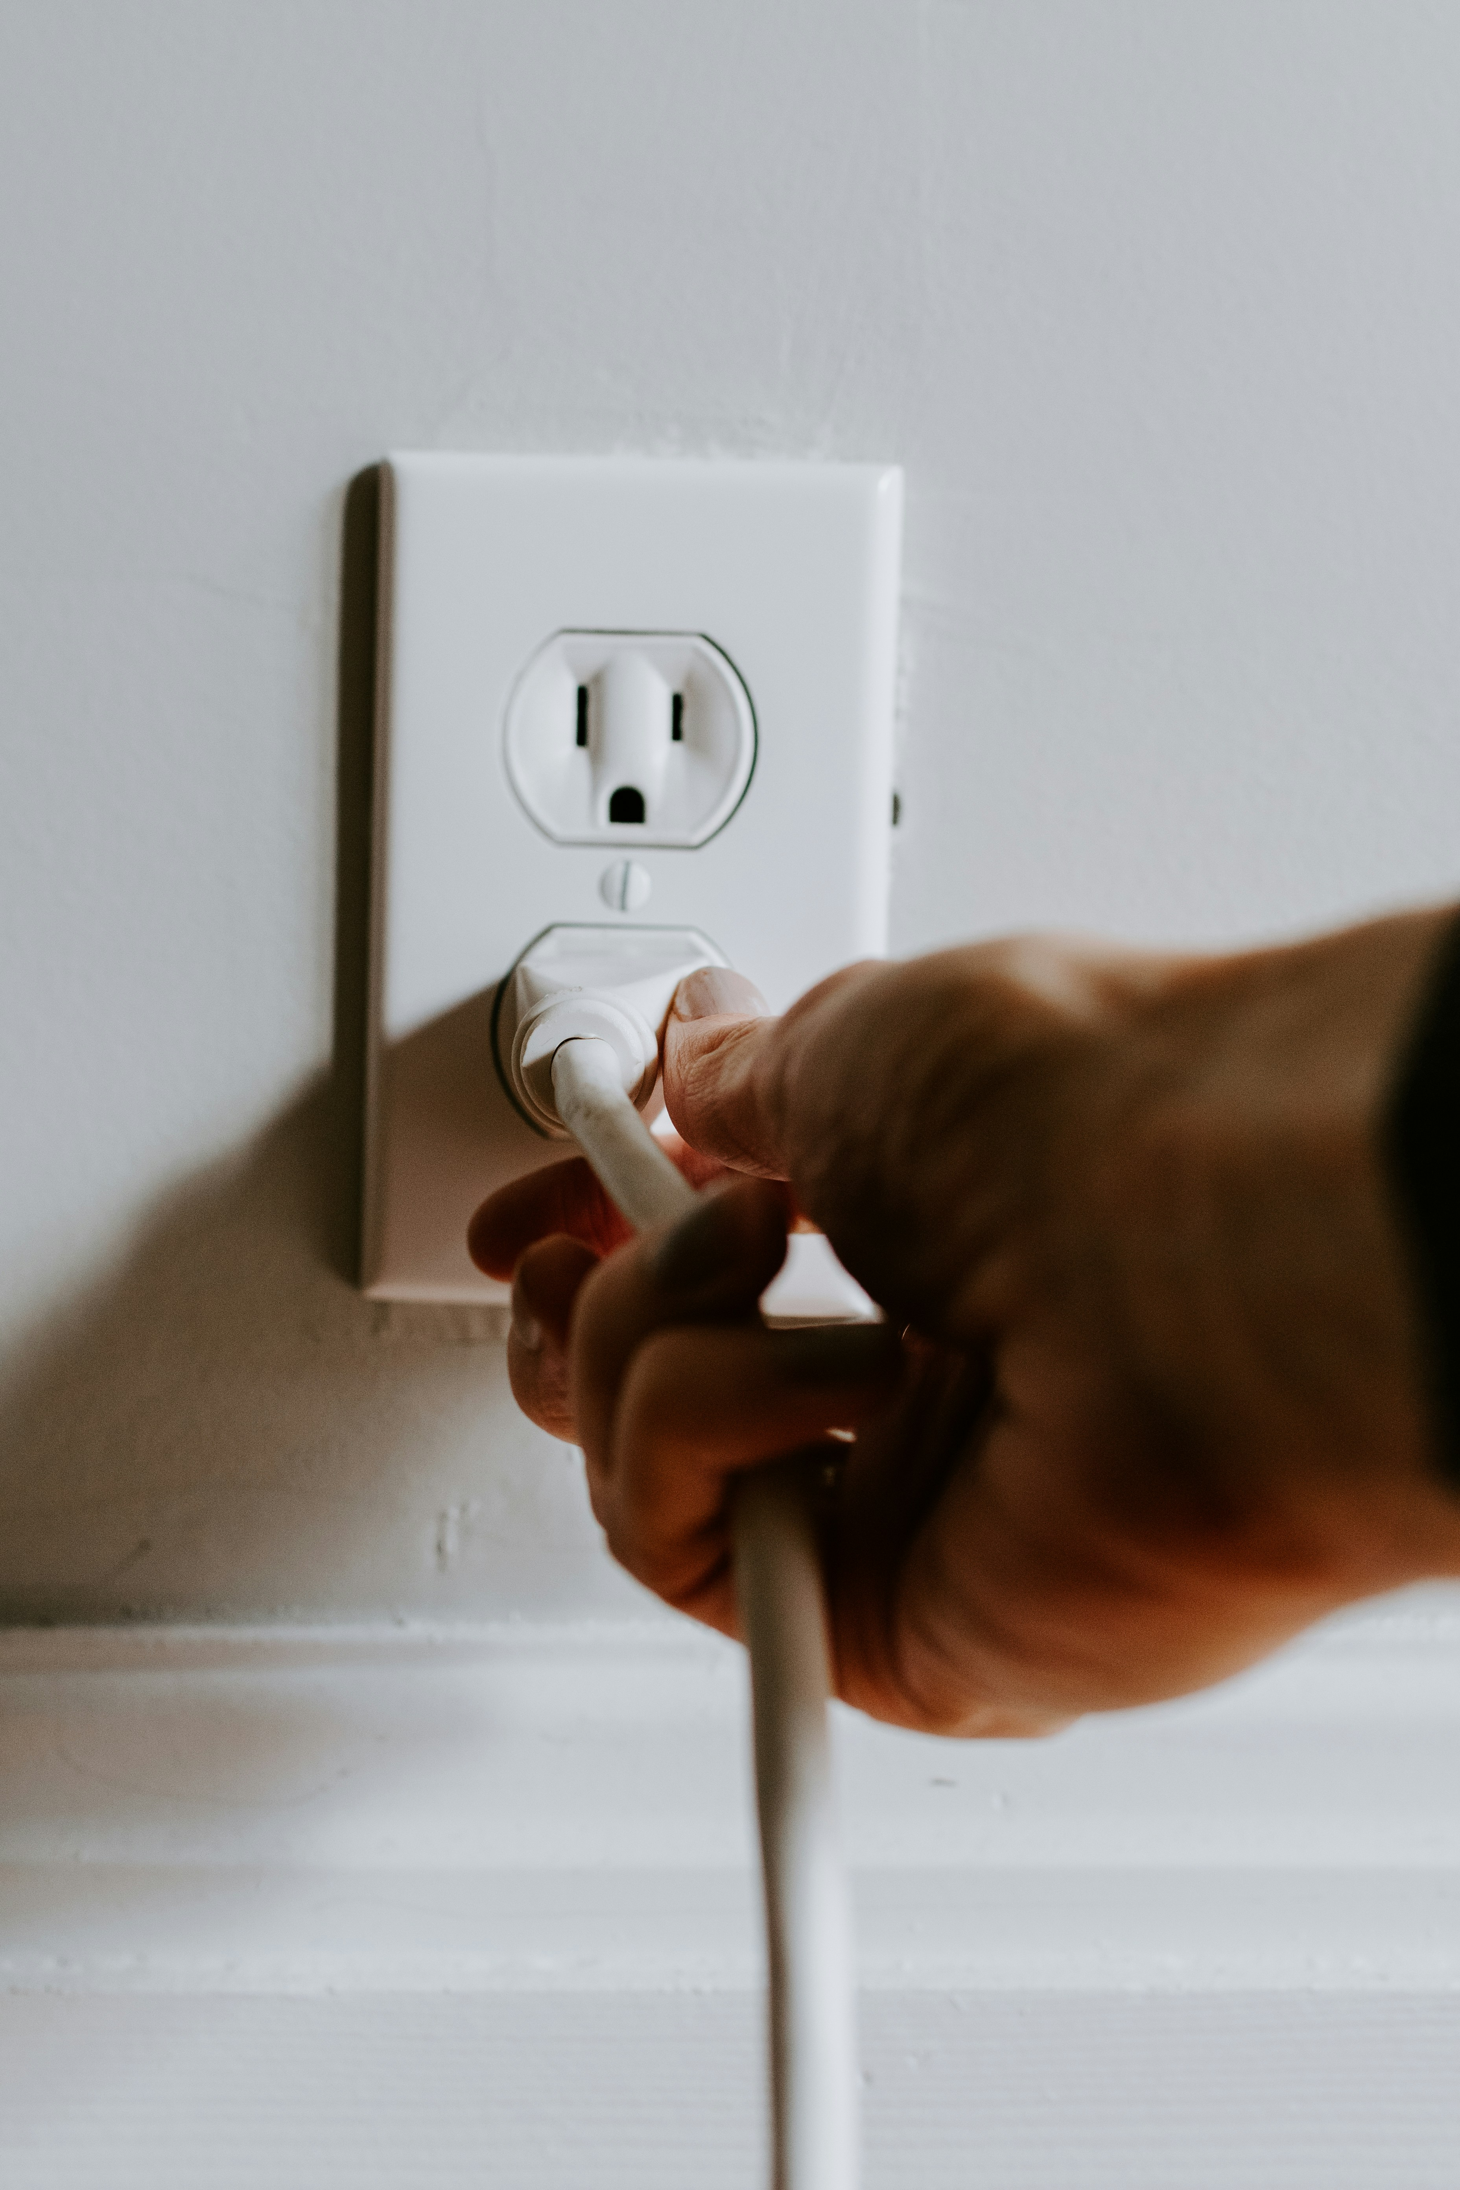

Uni-Connect: An Automated Communication-Based Academic
Support System for McPherson University
BY
OLALERE DAHUNSIMI JOSEPH
210202024
Department Of Computer Sciences,
College of Computing.
McPherson University, Seriki Sotayo, Ogun State.
Supervised by Mr. OYEDELE

Slide 2


PRESENTATION OUTLINE:
INTRODUCTION
STATEMENT OF PROBLEM
AIM & SPECIFIC OBJECTIVES
SIGNIFICANCE & SCOPE OF STUDY
LITERATURE REVIEW
METHODOLOGY
IMPLEMENTATION
CONCLUSION
REFERENCES

Slide 3


Introduction
Introducing Uni-Connect: It is a leap towards bridging the communication gap in academic support at McPherson University.
Parental and lecturer involvement in student academics is necessary to enhance academic achievements (Doi et al., 2020).
Uni-Connect, an automated system aimed at improving McPherson University’s monitoring of student progress and parental involvement.

Slide 4
AIM
The aim of this study is to develop Uni-Connect, an automated communication-focused academic support system for McPherson University, to enhance parental and lecturer involvement in student academics.

Slide 5
Statement of Problem
Parental involvement in academic activities is declining, a problem facing many universities around the world (Boonk et al., 2018).
The education community has not been able to develop a useful parental involvement system that positively influences students’ learning outcomes at the bachelor degree level.

Slide 6
Specific Objectives
Develop an Automated Academic Support System: Create an efficient and automated system specifically designed for McPherson University
Facilitate Seamless Communication: Establish a platform that allows smooth and effective communication .
Efficient Tracking of Student Attendance and Performance: Implement features that enable the accurate tracking and management of student attendance.
Reliable Notification System: Develop a notification system that delivers timely academic updates and reminders to users.
.

Slide 7

Scope of Study
The study is limited to the context of McPherson University and its community, focusing on addressing specific challenges identified within this academic environment and aiming to create a model that could potentially be adapted by other institutions facing similar challenges.

Slide 8
Significance of Study
The Uni-Connect system will significantly enhance the academic support provided to students by streamlining communication and access to academic resources. This improvement can lead to better student performance and academic success.

Slide 9
Literature Review
Citation | Objectives | Methodology | Results | Identified gap
Motz, B. A., Mallon, M. G., & Quick, J. D. (2021). Automated Educative Nudges to Reduce Missed Assignments in College. IEEE Transactions on Learning Technologies, 14(2), 189–200. doi:10.1109/tlt.2021.3064613 | The primary objective of the study was to reduce missed assignments and improve student outcomes in online learning environments. This was to be achieved by designing and evaluating a scalable, targeted intervention: a mobile app that would deploy push notifications to students | The study was conducted through two experimental pilots, each designed to test the effectiveness of the mobile app intervention in different contexts. | Experiment 1: Demonstrated that the mobile app intervention significantly decreased missed assignments when compared with the control group that received only general class announcements. Experiment 2: Showed that the use of the app led to improved assignment adherence and better course grades compared to courses that did not use the intervention. | The study does not address whether the positive effects of the intervention (reduced missed assignments, improved grades) persist over the long term or if they diminish as the novelty of the app wears off.

Slide 10
Literature Review Cont’d
Citation | Objectives | Methodology | Results | Identified gap
Doi, S., Isumi, A., & Fujiwara, T. (2020). The association between parental involvement 142 behavior and self-esteem among adolescents living in poverty: Results from the K-CHILD Study. International Journal of Environmental Research and Public Health, 17(17). https://doi-org./10.3390/ijerph17176277 | The primary objective of the study is to investigate the relationship between parental involvement behaviors and the self-esteem of adolescents living in poverty. | The study involves fifth-, eighth-, and 11th-grade students living in Koichi prefecture, Japan, as part of the Kochi Child Health Impact of Living Difficulty (K-CHILD) study in 2016. The total sample size is 10,784 participants. | The study finds a positive association between the number of parental involvement behaviors and the self-esteem scores of adolescents. This association holds true for both adolescents living in poverty and those not living in poverty. | These gaps could contribute to a more comprehensive understanding of the complex interplay between parental involvement, socioeconomic factors, and the development of self-esteem in adolescents, especially those facing economic adversity.

Slide 11
Literature Review Cont’d
Citation | Objectives | Methodology | Results | Identified gap
Hornby, G., & Blackwell, I. (2018). Barriers to parental involvement in education: an update. Educational Review, 70(1), 109–119. doi:10.1080/00131911.2018.1388612 | The study aims to investigate the impact of online learning tools on the academic performance of undergraduate students during the COVID-19 pandemic | The methodology involved a quantitative research design, surveying 500 undergraduate students across five universities. Data were collected through online questionnaires and analyzed using statistical software to compare academic performance before and during the use of online learning tools. | The results indicated that students who consistently used online learning tools scored, on average, 10% higher on their exams compared to students who did not use these tools. | While the study found positive outcomes associated with online learning tools, it identified a gap in the availability of digital resources for students in rural areas.

Slide 12
Literature Review Cont’d
Citation | Objectives | Methodology | Results | Identified gap
Qureshi, K. N., Naveed, A., Kashif, Y., & Jeon, G. (2021). Internet of Things for education: A smart and secure system for schools monitoring and alerting. Computers & Electrical Engineering, 93, 107275. doi:10.1016/j.compeleceng.2021.107275 | The primary objective of the paper is to analyze Internet of Things (IoT) solutions specifically designed for schools, with a focus on enhancing security and privacy within educational settings. | The paper likely conducts a review of existing literature to establish the context of security and privacy concerns in educational organizations, the adoption of technologies for smart learning, and the current state of IoT solutions in schools. | The paper presents results indicating that the S-IoST system enhances security within educational institutions by leveraging advanced communication systems and IoT technologies. | The identified gaps suggest potential avenues for further research to refine and validate the proposed S-IoST system, ensuring its effectiveness, usability, and adaptability across various educational settings.

Slide 13
Literature Review Cont’d
Citation | Objectives | Methodology | Results | Identified gap
Fantozzi, F., Hamdi, H., Rocca, M., & Vegnuti, S. (2019). Use of Automated Control Systems and Advanced Energy Simulations in the Design of Climate Responsive Educational Building for Mediterranean Area. Sustainability, 11(6), 1660. doi:10.3390/su11061660 | The primary objective of this paper is to address the challenges posed by climate change in the context of building design. Specifically, the study aims to enhance conventional bioclimatic design with the integration of Building Automation Control Systems (BACS) to create climate-responsive constructions. | The paper likely begins with a review of existing literature on climate change, building design strategies, and the limitations of current approaches, including the nZEB concept and voluntary labeling systems. | The study reports positive results in terms of indoor adaptive thermal comfort. The simulated operative temperature complies with the adaptive comfort model for more than 98% of the reference year. | The study provides insights into short-term and simulated performance, but a gap may exist in understanding the long-term performance and maintenance considerations of buildings with integrated bioclimatic design and BACS.

Slide 14
Methodology
The use of Python libraries to automate tasks and use of frame works like flask to design the user interface.
The use of QR codes to collect data of students available for class.
The use of mySql for data manipulation and analysis.
Using Openpyxl to handle Excel files for result management.
using APScheduler for automated appointment scheduling.

Slide 15
Methodology
.
Analysis
Requirement Gathering
Design
Coding
&
Implementation
Testing
&
Maintenance
SDLC PHASES

Slide 16



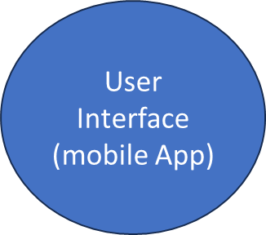
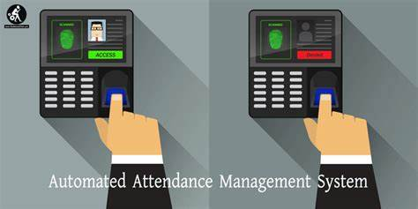
Uni-Connect Server
fmgfmfmf
Communication Module
Result Management System
Appointment Booking system
Automated Attendance System
SYSTEM ARCHITECTURE FOR UNI-CONNECT FIGURE 1

Slide 17
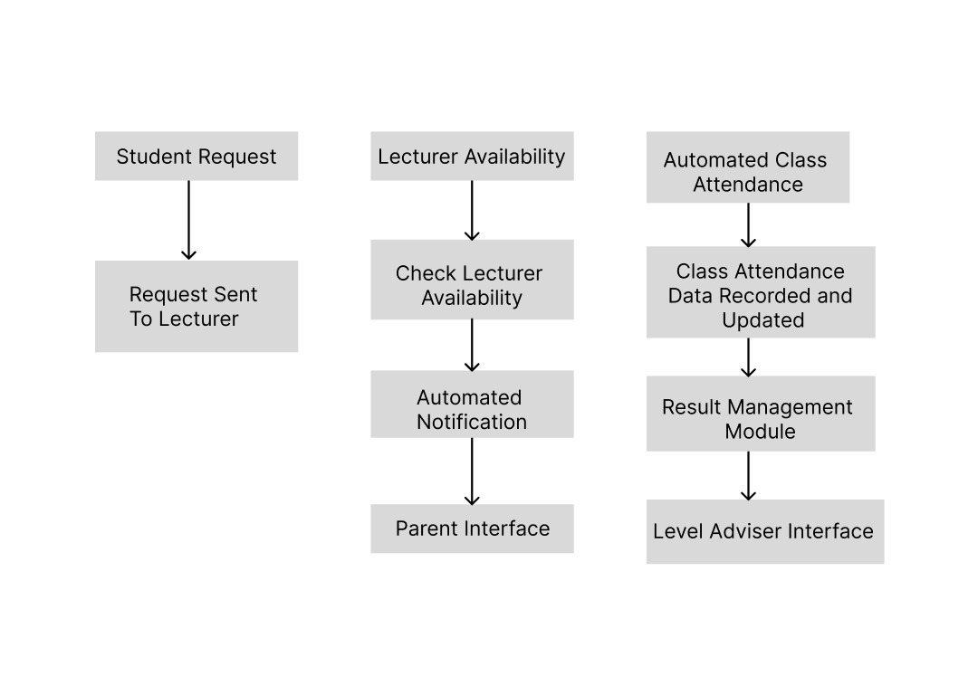
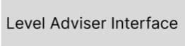
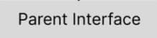
Lecturer
PROJECT FLOW

Slide 18
Use Case Diagram
Lecturers
Student
Parents
Login
Login
Receive Automated Feedback
Generate QR Code
Scan QR Code
View Result
Receive and send feedback
View Grades
Login
Book appointments
Book appointment
Receive notifications

Slide 19
Methodology
Backend Development
Technologies Used:
Python
Flask
MySQL
Frontend Development
Technologies Used:
Html
CSS
Bootstrap
Jquery
Javascript
Integration
Frontend and Backend Integration:
RESTful APIs
AJAX
Secure Data Transmission with HTTPS
Consistent Data Synchronization between Client and Server

Slide 20
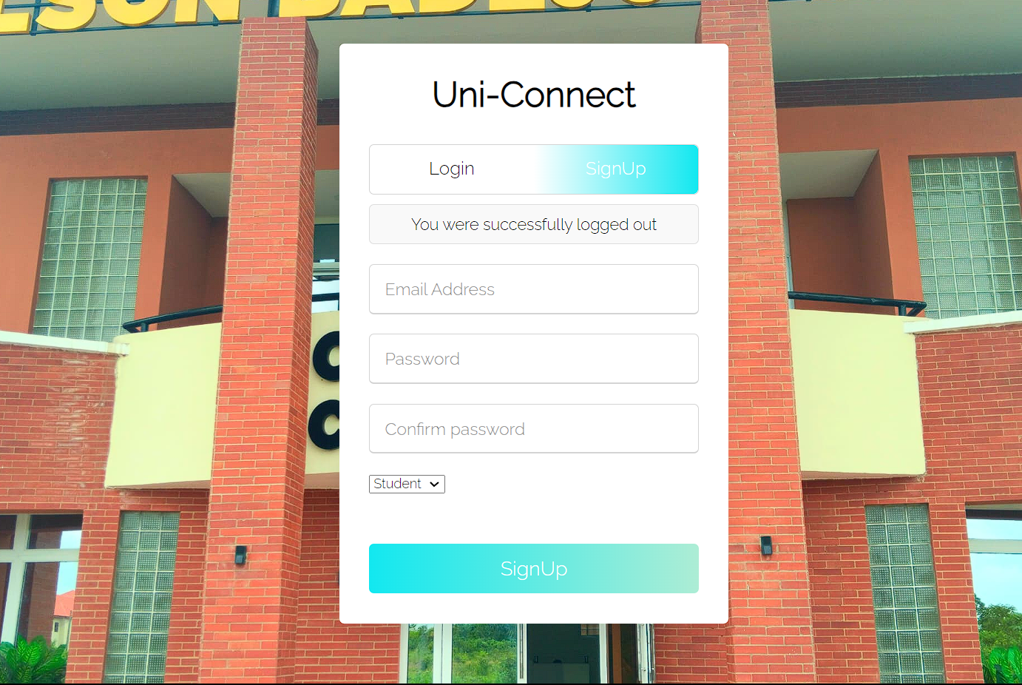
Implementation
.
Sign in and Sign up page

Slide 21

Implementation
.
Landing page for users

Slide 22
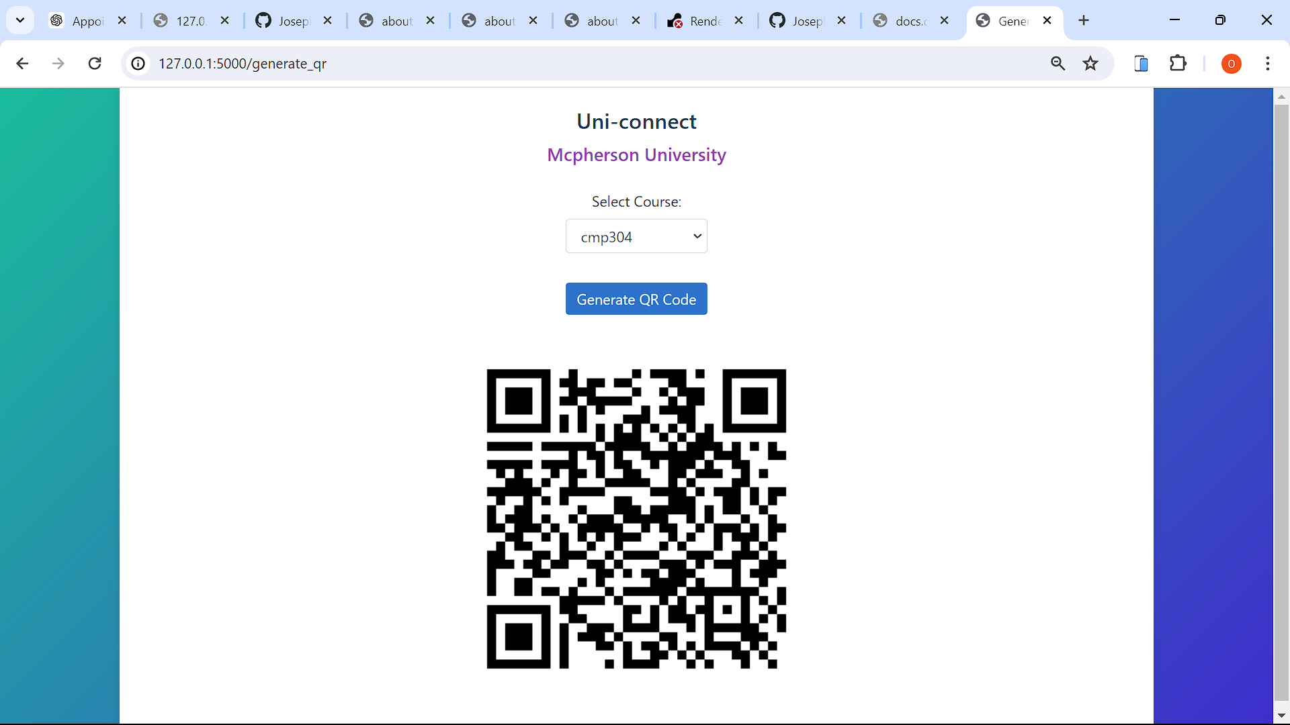
Implementation
.
QR code for student to scan

Slide 23
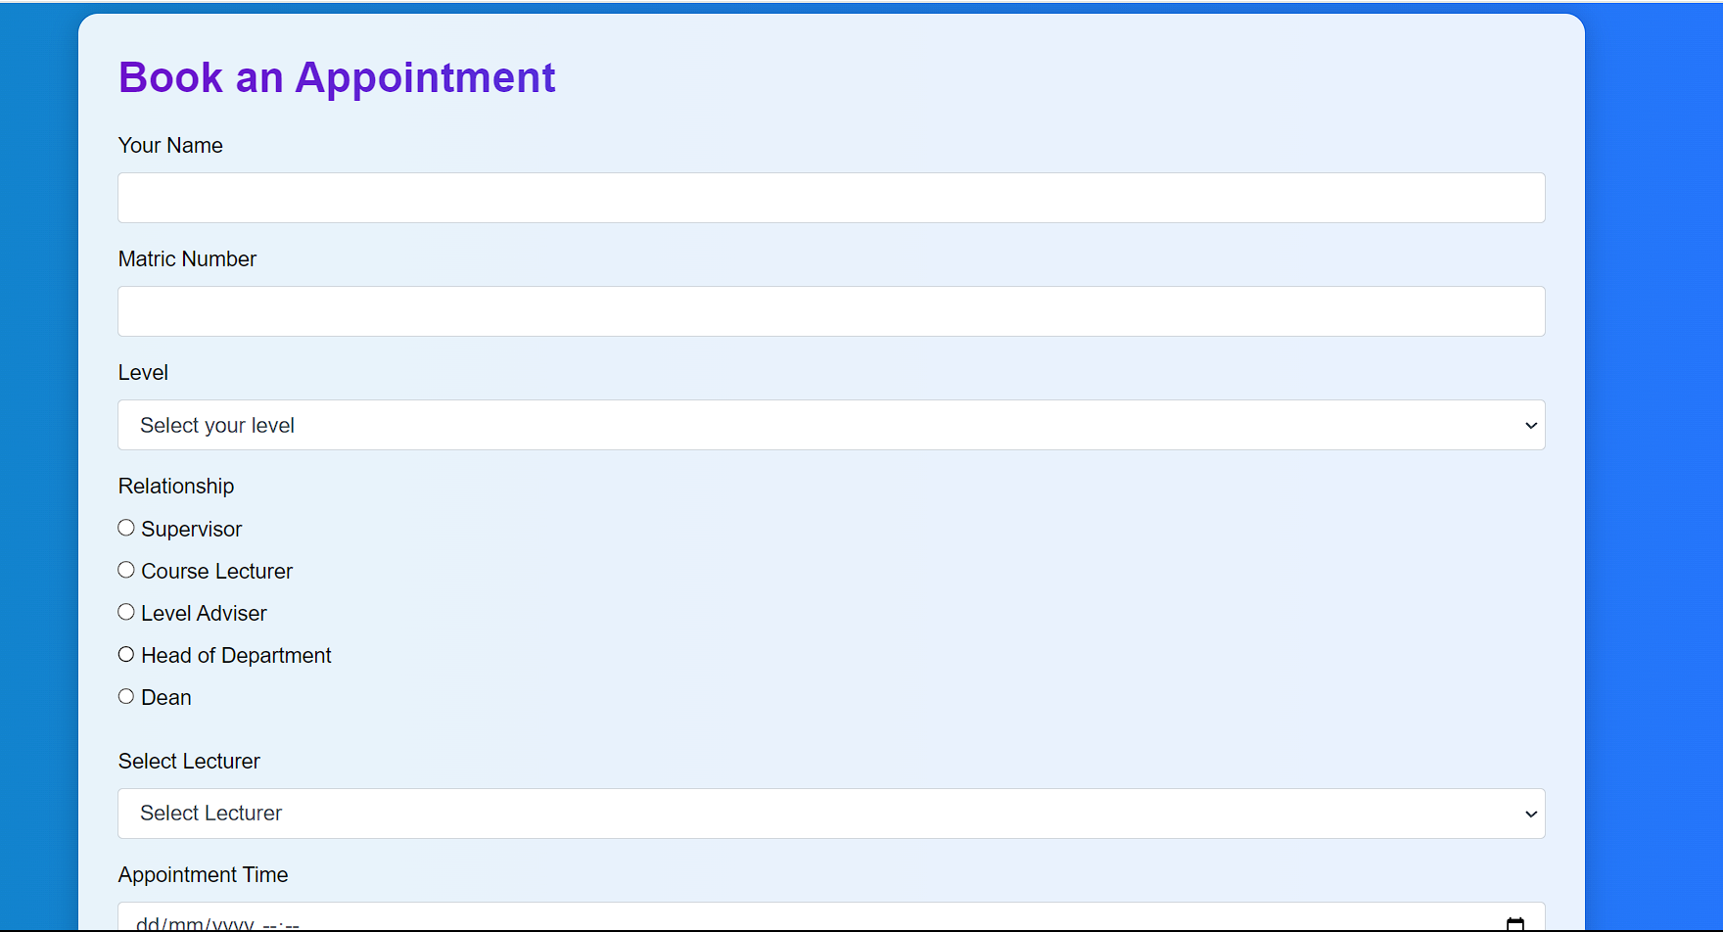
Implementation
.
Book Appointments with lecturers

Slide 24
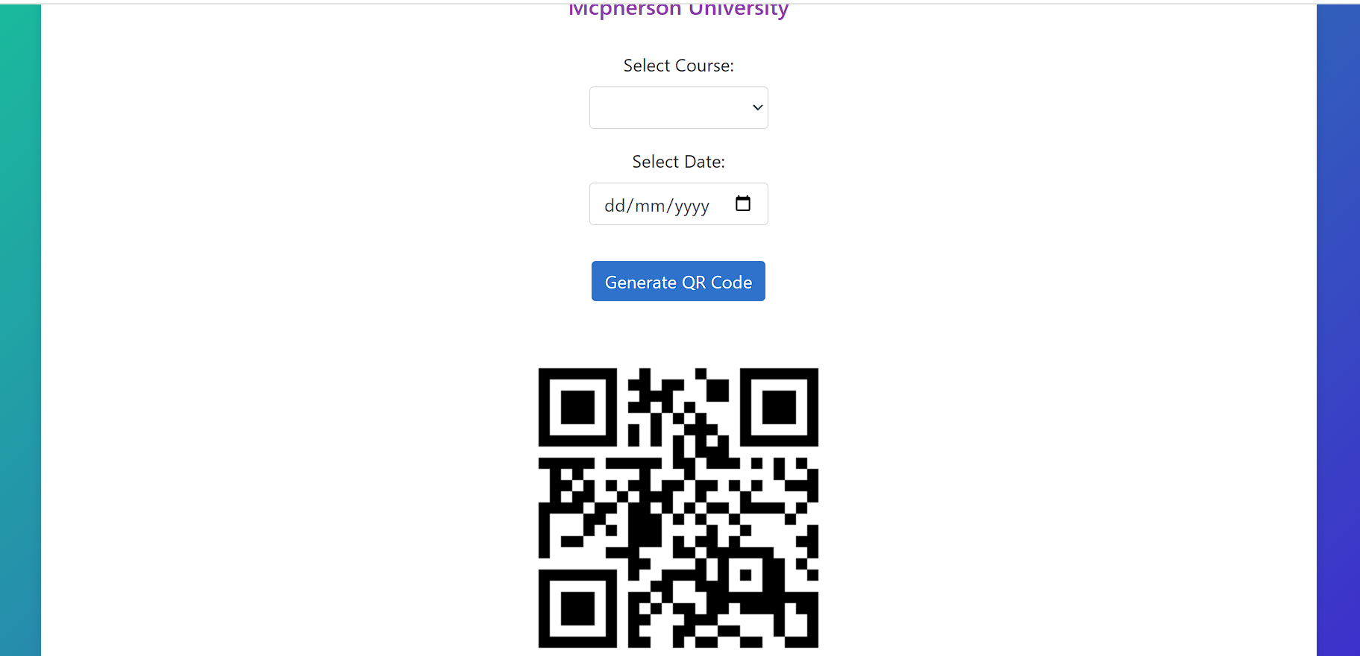
Implementation
.
QR code generator for student to scan

Slide 25
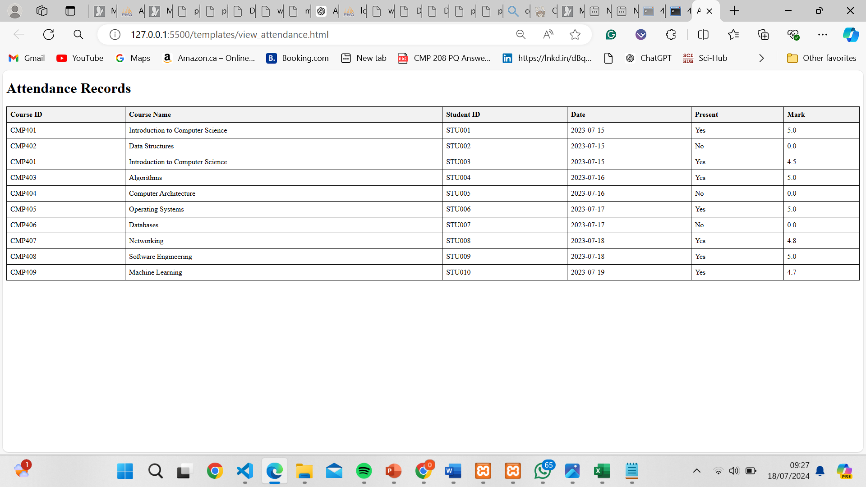
Implementation
.
List of student for attendance forum

Slide 26
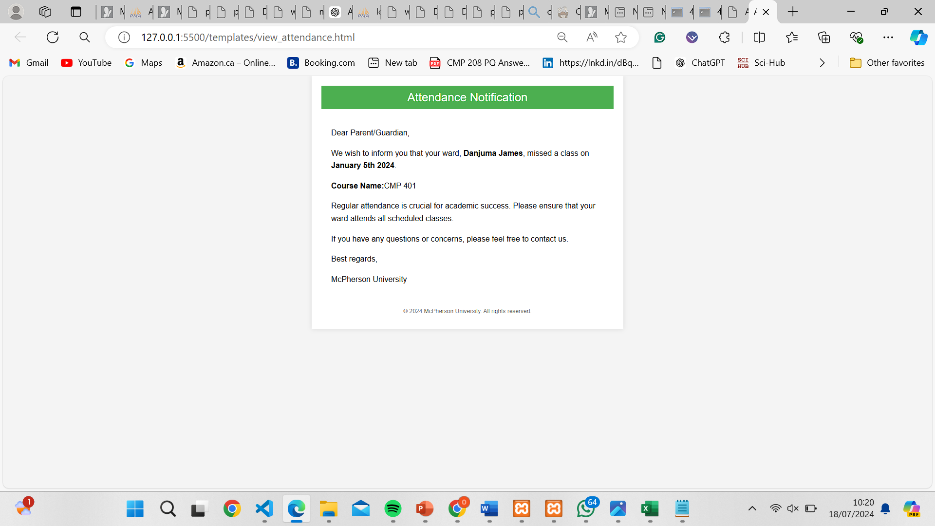
Implementation
.
Automated message to parents

Slide 27
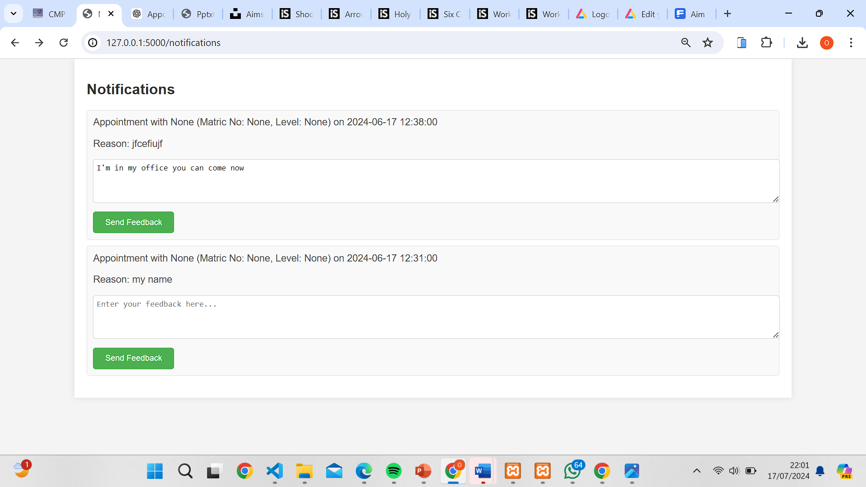
Implementation
.
Notification System

Slide 28
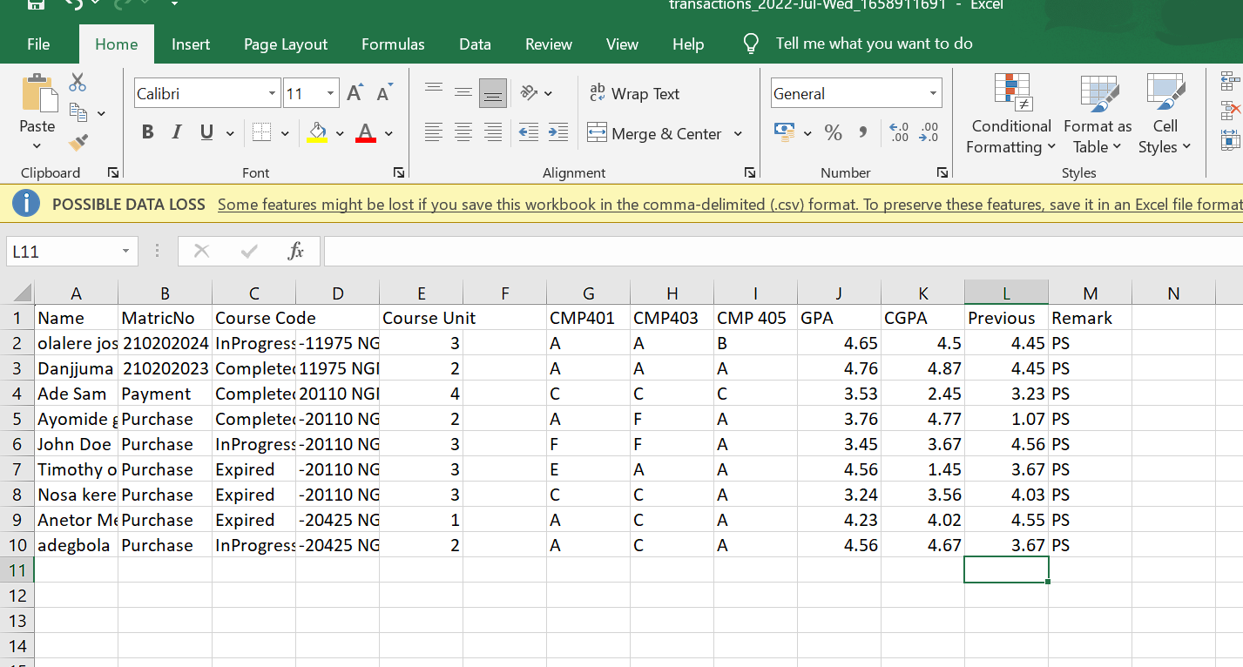
Implementation
.
List of student results that will be appended to the parent forum

Slide 29
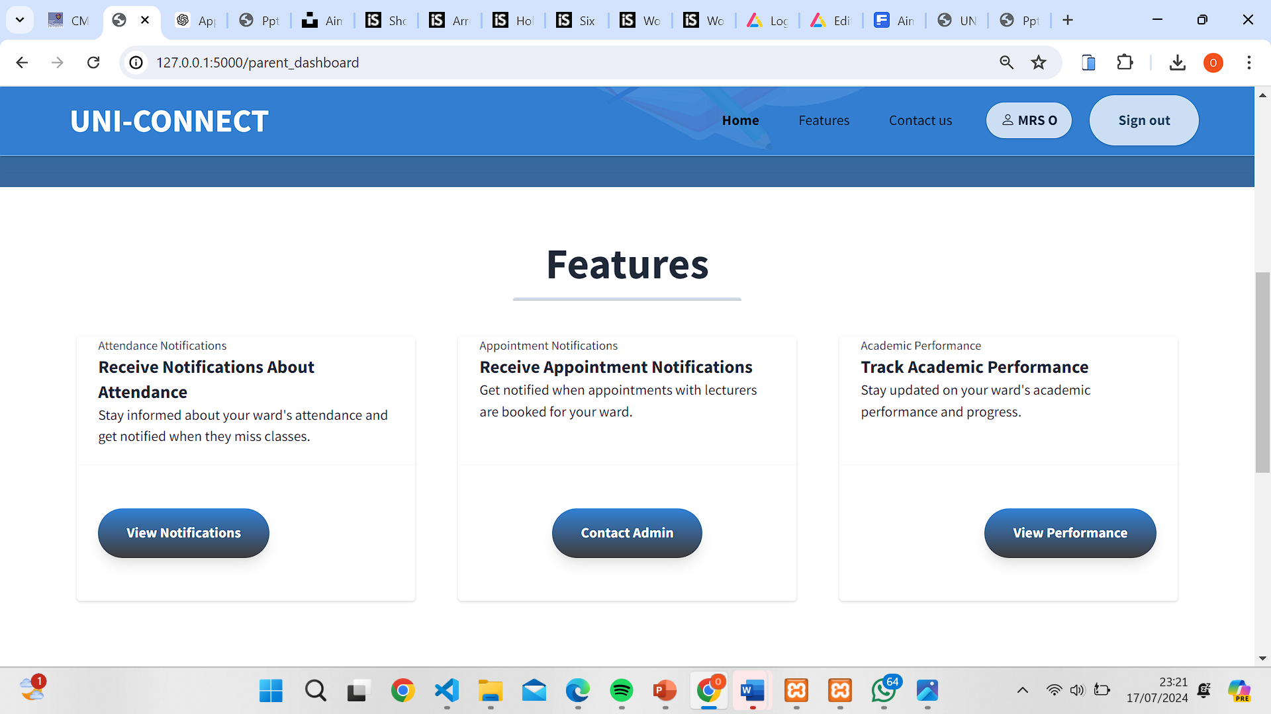
Implementation
.
Features of the parent platform

Slide 30
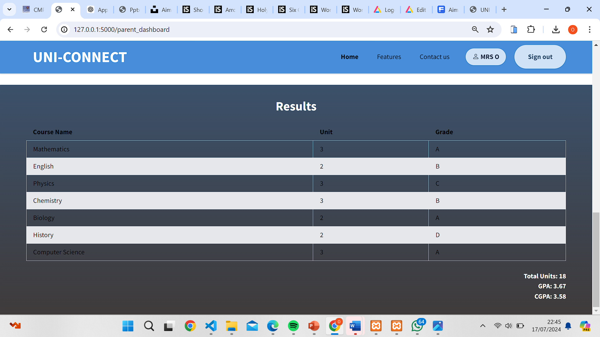
Implementation
.
Result of students in parent forum

Slide 31
Conclusion
The Uni-Connect project represents a significant advancement in the integration of technology into the academic framework of McPherson University. Through the development and implementation of an automated communication-based academic support system, this project addresses several critical needs and enhances the overall educational experience for students, lecturers, and administrators.

Slide 32
References
Boonk, L., Gijselaers, H. J., Ritzen, H., & Brand-Gruwel, S. (2018). A review of the 138 relationship between parental involvement indicators and academic achievement. Educational Research Review, 24, 10-30. https://doi.org/10.1016/j.edurev.2018.02.001
Doi, S., Isumi, A., & Fujiwara, T. (2020). The association between parental involvement 142 behavior and self-esteem among adolescents living in poverty: Results from the K-CHILD Study. International Journal of Environmental Research and Public Health, 17(17). https://doi-org./10.3390/ijerph17176277
Motz, B. A., Mallon, M. G., & Quick, J. D. (2021). Automated Educative Nudges to Reduce Missed Assignments in College. IEEE Transactions on Learning Technologies, 14(2), 189–200. ). https://doi-org./10.1109/tlt.2021.3064613
Hornby, G., & Blackwell, I. (2018). Barriers to parental involvement in education: an update. Educational Review, 70(1),109–119. https://doi-org./10.1080/00131911.2018.1388612
Qureshi, K. N., Naveed, A., Kashif, Y., & Jeon, G. (2021). Internet of Things for education: A smart and secure system for schools monitoring and alerting. Computers & Electrical Engineering, 93, https://doi-org./10.1016/j.compeleceng.2021.107275

Slide 33
THANK YOU

